Slide 1
Aspen Falls Online Job Fair
OCTOBER 1 – 5
ASPEN FALLS COMMUNITY CENTER AND WWW.ASPENFALLS.ORG.
53 area employers!

Slide 2
JOB FAIR INFORMATION
Recruiting for hundreds of positions
  IT
  Healthcare
  Business
  Skilled trades

Slide 3
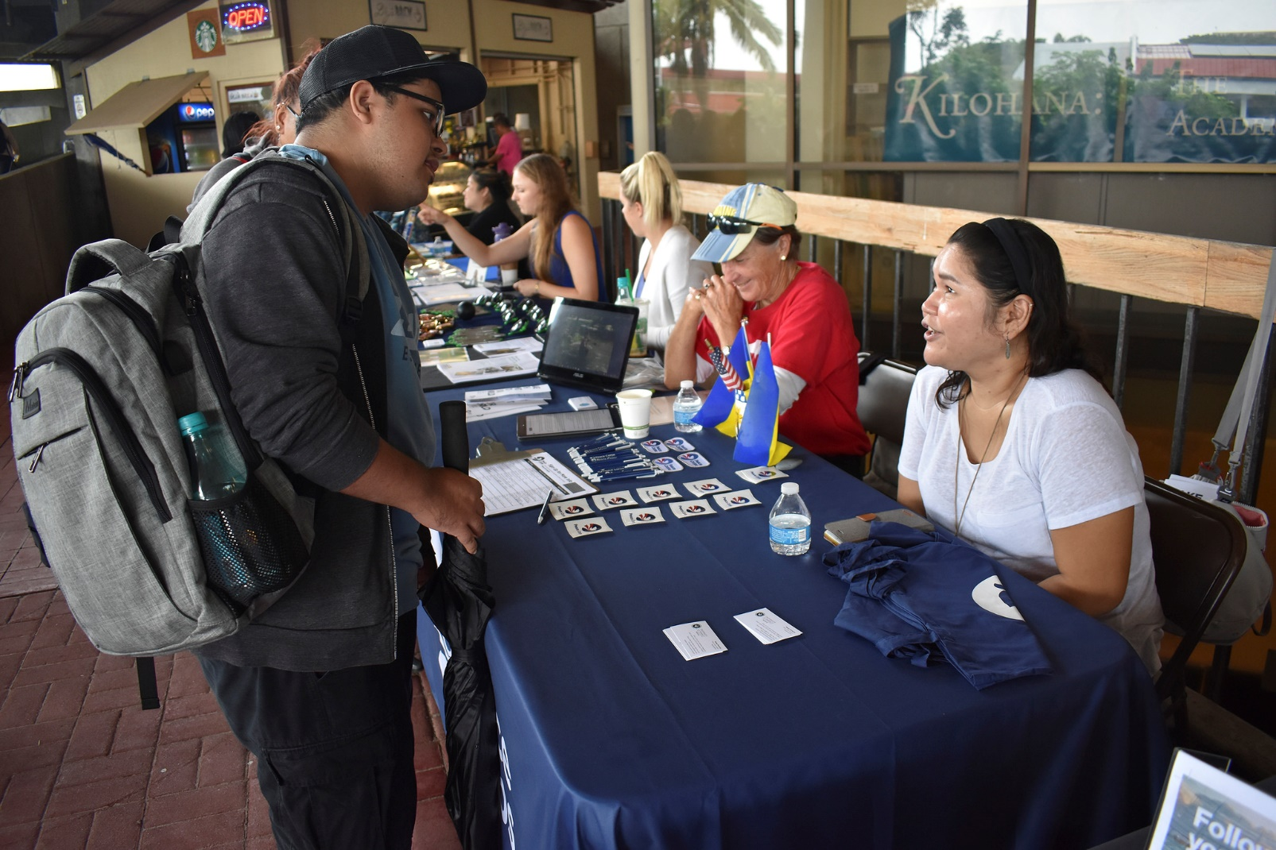
OCTOBER 1 - 5
Aspen Falls Community Center or www.aspenfalls.org.
505 S Aspen St, Aspen Falls, CA
9:00 a.m. – 6:00 p.m.

Slide 4
WHAT TO BRING
Resume | References
Portfolio | Schedule

Slide 5
JOB GROWTH IN ASPEN FALLS

